Slide 1
BIG DATA ANALYTICS
Project: PREDICTING POTENTIAL LEADS
Spring 2023 – February 22, 2023

Slide 2
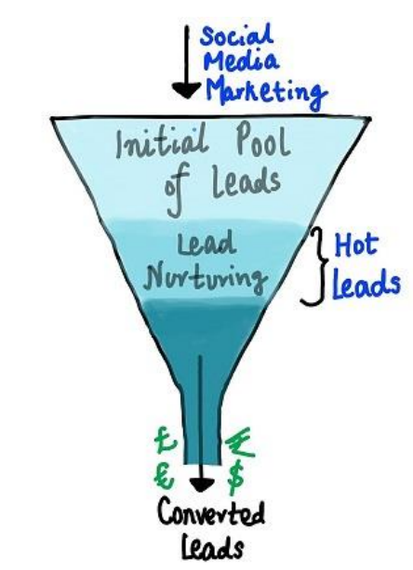
Problem Statement
Online courses are sold by a corporation named X Education, which are advertised on several websites. When people fill out a form with their phone number and email address they are categorized as leads.
The sales team communicates with these leads in order to convert them into customers. Some leads are converted, while others are not. The conversion rate is often low around 30%, reducing their efficiency. Businesses spend a lot of money on their sales and marketing teams.
Our objective is to build a model where we will find the prospective customers. So that the sales team can properly nurture the potential leads.
Notes:
Charanya

Slide 3
Proposed Solution
To identify potential clients who are more likely to convert into customers, we planned to create models utilizing classification approaches like Logistic Regression, Decision Tree, and Random Forest.
To increase the conversion rate, X Education only needs to focus on the most likely potential clients first.
We will give the company all the necessary information on which potential customers to prioritize, so they can operate efficiently.
Notes:
Charanya

Slide 4
Overview
Data Exploration
Data Preprocessing
Feature Engineering
Model Training and Validation
Result

Slide 5
Exploratory Data Analysis
Notes:
Sri

Slide 6
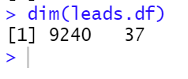
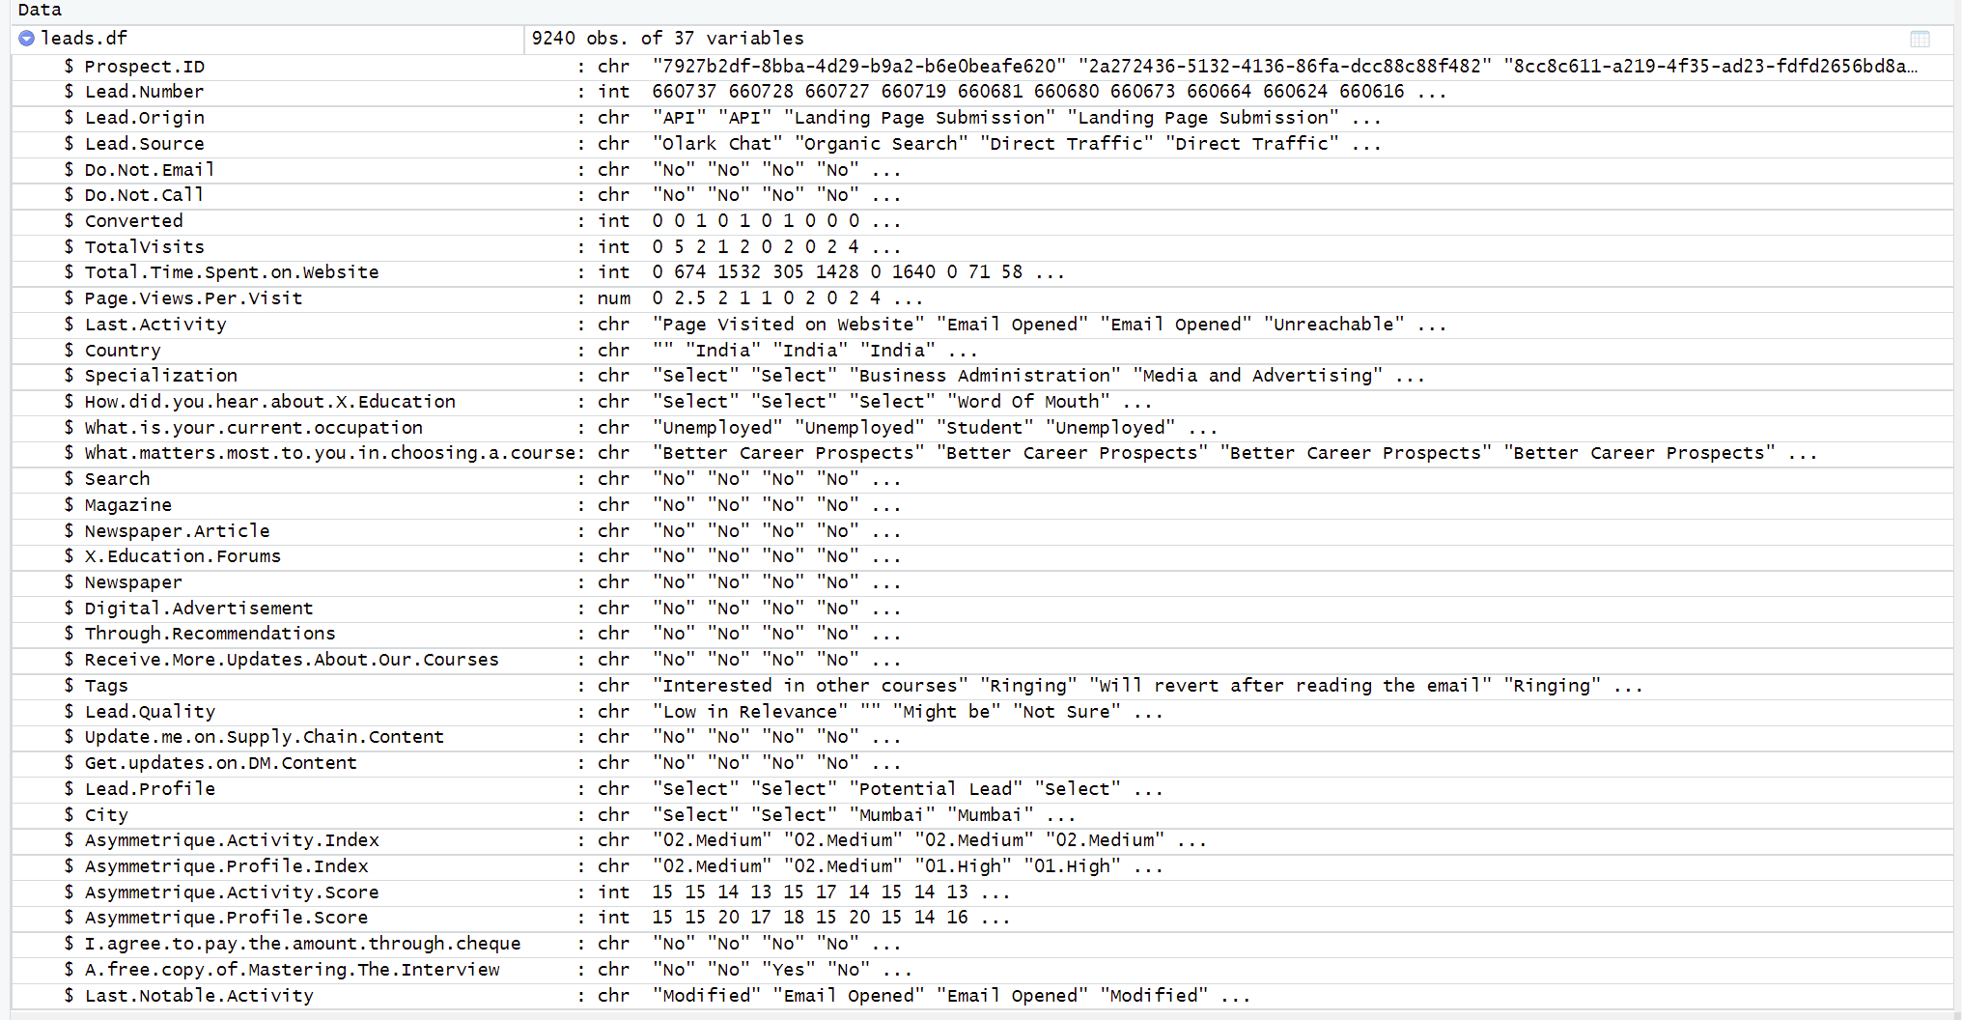
Dataset Before Cleansing
data
Rows | 9240
Columns | 37

Slide 7
Data Cleansing
Notes:
Sri

Slide 8
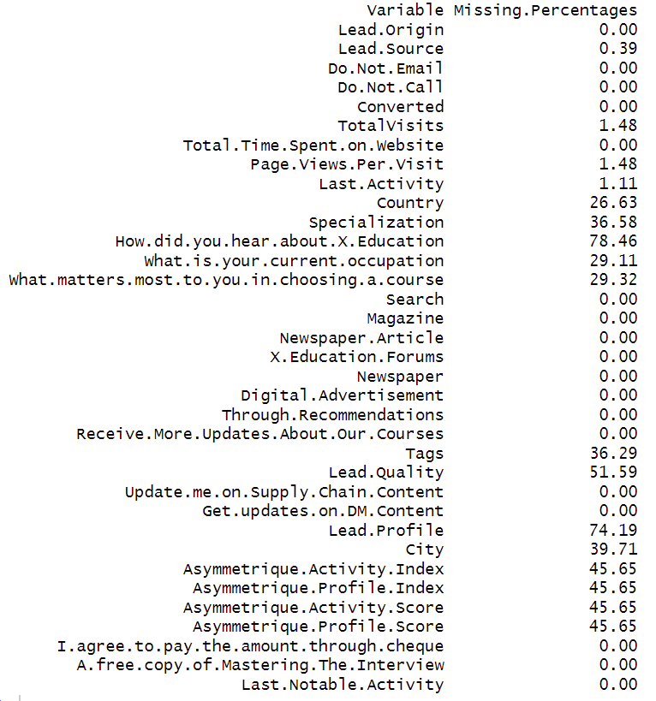
Null value percentages
Since, the count of null values does not give a clear picture, we have taken the percentage of null values in each column for making a better analysis.

Slide 9
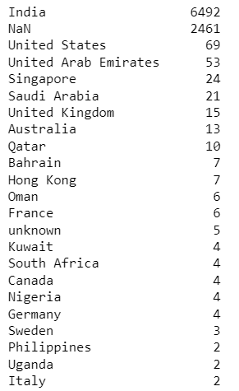
Handling Null values
We have dropped columns that have more than 40% Null values (which include 7 columns - How did you hear about ABC Education, Lead Quality, Lead Profile, Asymmetrique Activity Index, Asymmetrique Profile Index, Asymmetrique Activity Score, Asymmetrique Profile Score ).
Few of the other columns have one majority value, and a significant Null value percentage, So we have dropped those columns too.
Example: The country column has majority values as India, and it also has around 27% Null values (2461) so we have dropped it.

Slide 10
Analyzing Numerical Variables
Notes:
Sri

Slide 11
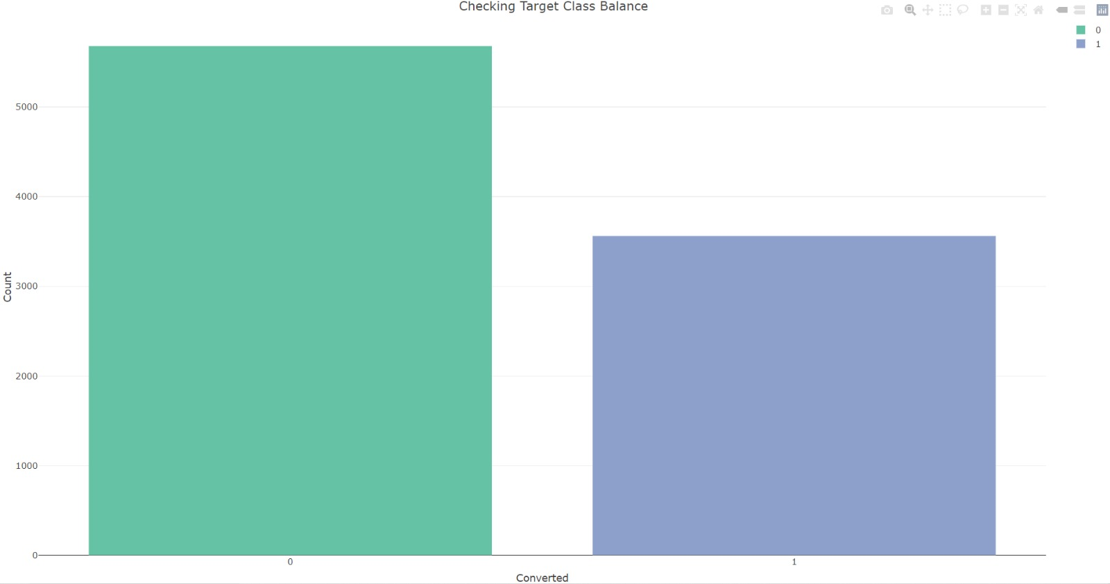
Checking if there is any imbalance in the distribution between Converted/Not Converted classes
From the above histogram the counts of converted and non converted leads seems balanced, and the data is not highly skewed.

Slide 12
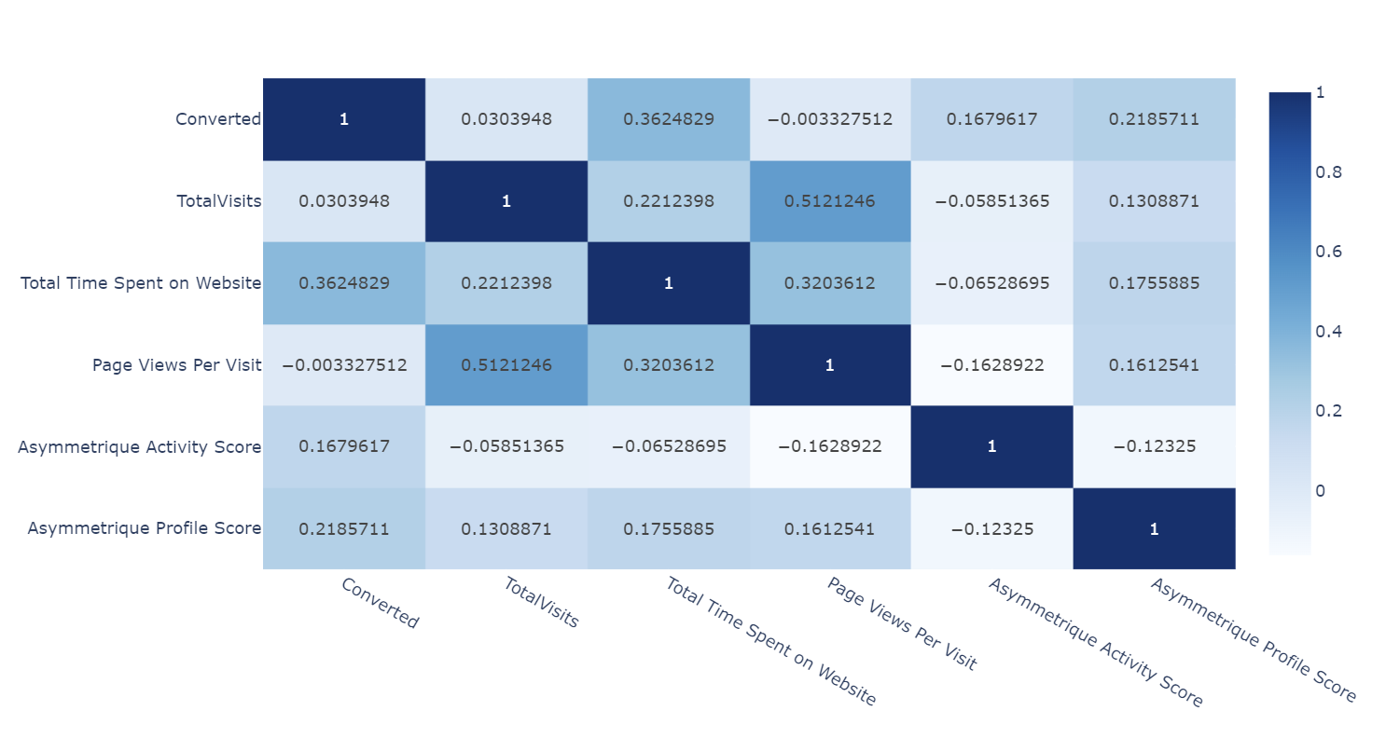
Correlation Matrix :
Implemented a correlation matrix between the numerical columns to discover the insights among them.
It is observed that there is more than 50% correlation between Total Visits and Page Views Per Visit

Slide 13
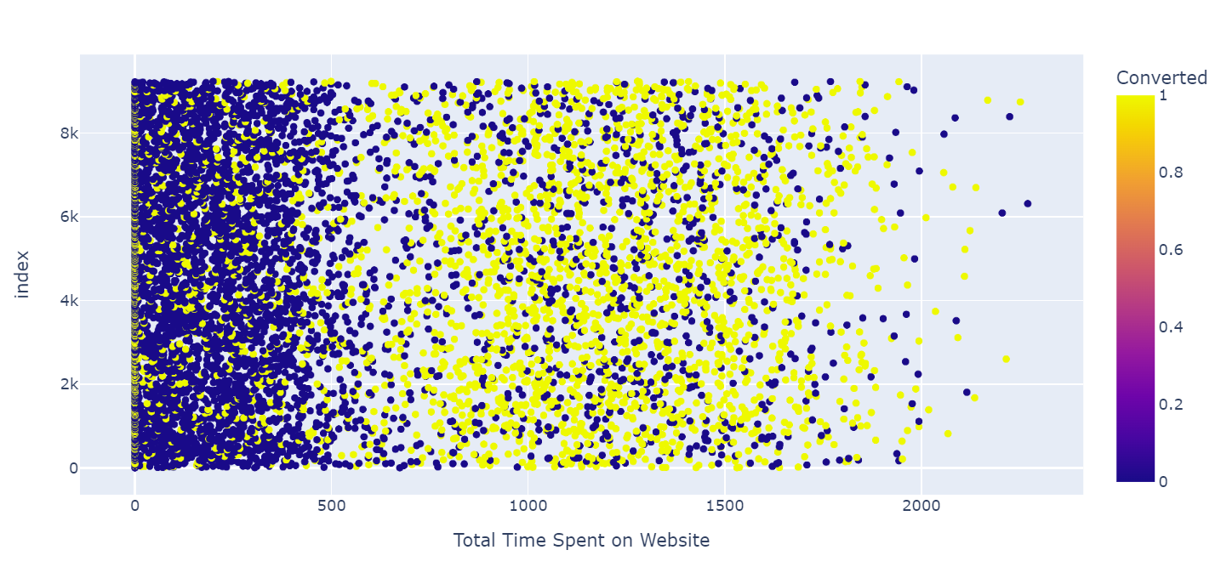
Scatter plot between Leads and Total Time Spent
Converted has the highest correlation with Total Time Spend on Website which tells us that the more time someone spends on this website the higher the chances of being converted as a paying customer

Slide 14
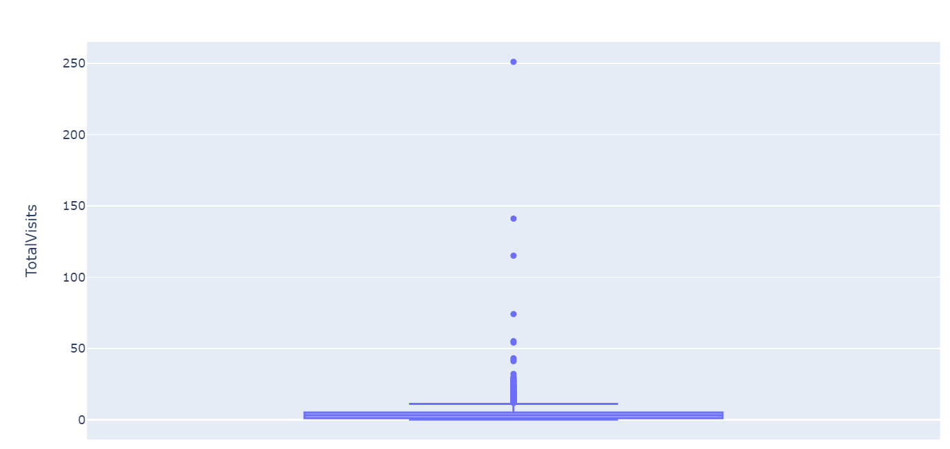
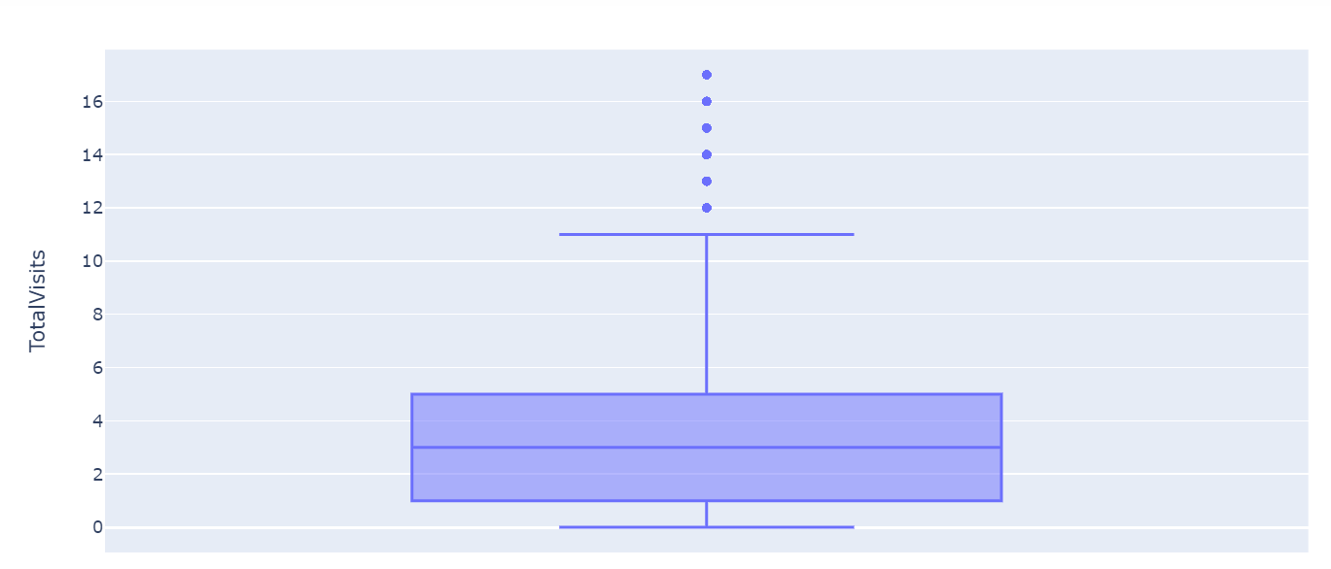
Checking for Outliers:
Implemented Box plot on the TotalVisits column to check if there are any outliers
Before removing outliers
After removing outliers
Removed top and bottom 1 percentile outliers from the column

Slide 15
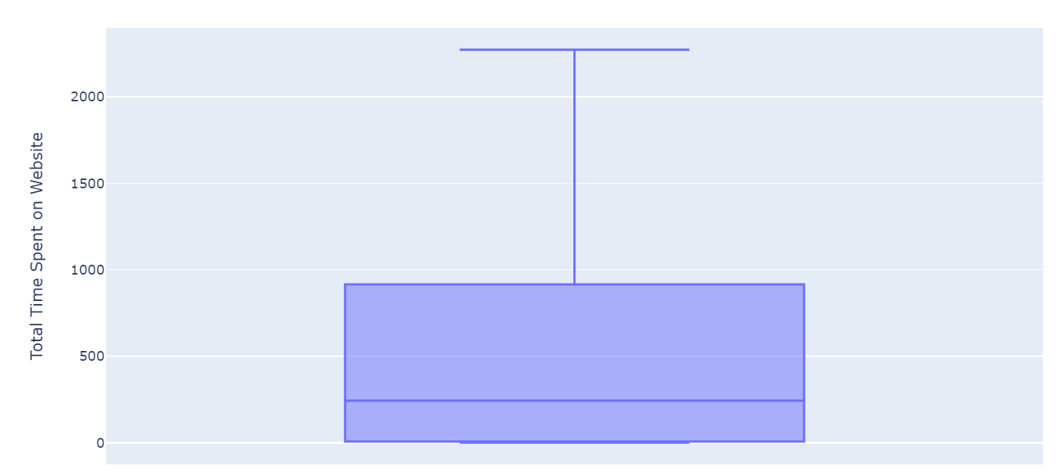
Checking for Outliers:
Implemented Box plot on the Total Time Spent on Website column to check if there are any outliers
No outliers present in "Total Time Spent on Website”

Slide 16
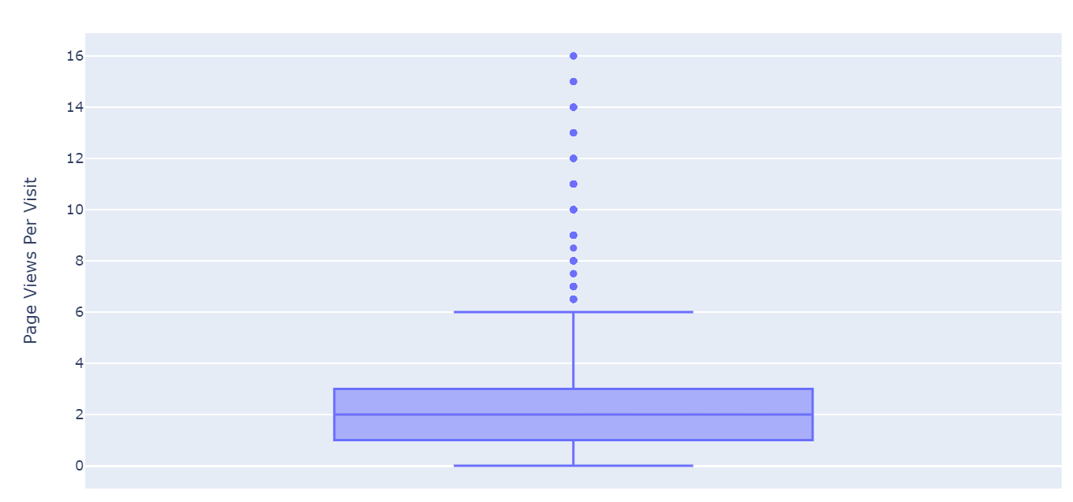
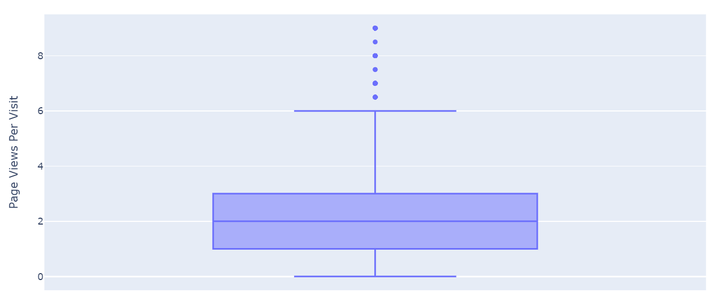
Checking for Outliers:
Implemented Box plot on the Page Views Per Visit column to check if there are any outliers
Before removing outliers
After removing outliers
Removed top and bottom 1 percentile outliers from the column

Slide 17
Analyzing Categorical Variables
Notes:
Sri

Slide 18
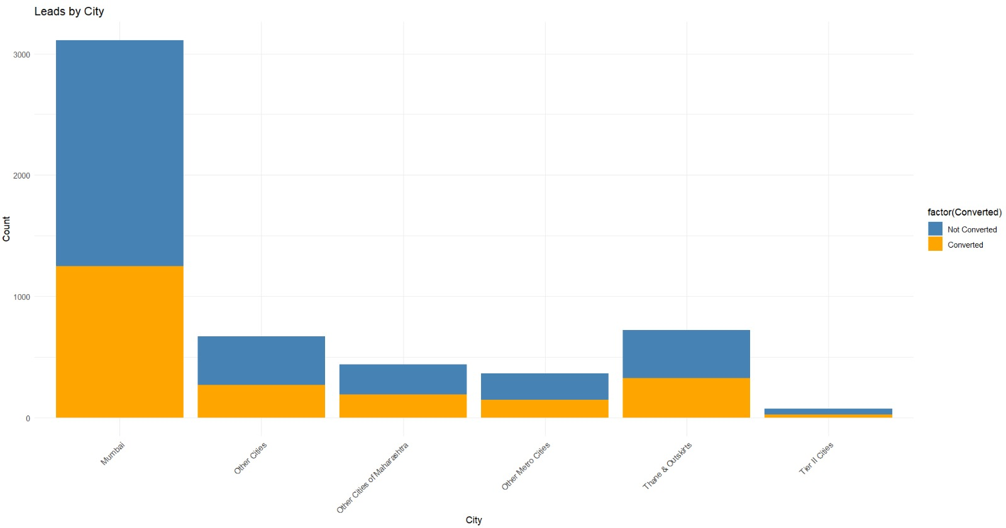
Analyzing Categorical Variable “CITY”
The below histogram shows we have maximum leads from Mumbai and as the data is not much skewed, we just replaced the null values as Not Specified

Slide 19
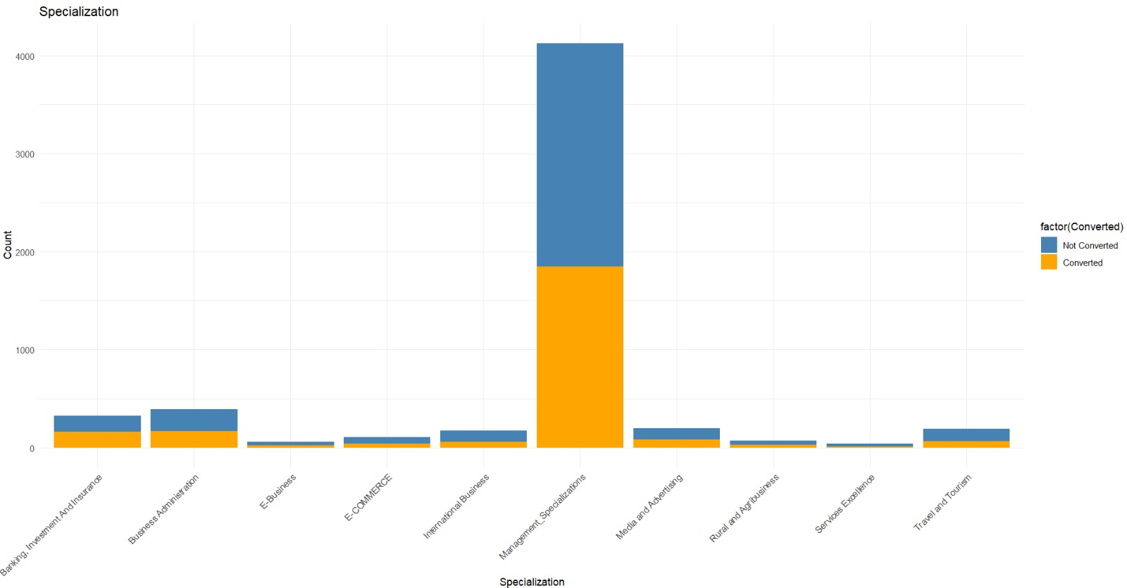
Analyzing Categorical Variable “SPECIALIZATION”
Replaced the null values as Not Specified and grouped all the management related specialization under Management_Specializations.
We can see that specialization with Management in them have higher number of leads as well as leads converted. So this is definitely a significant variable and should not be dropped

Slide 20
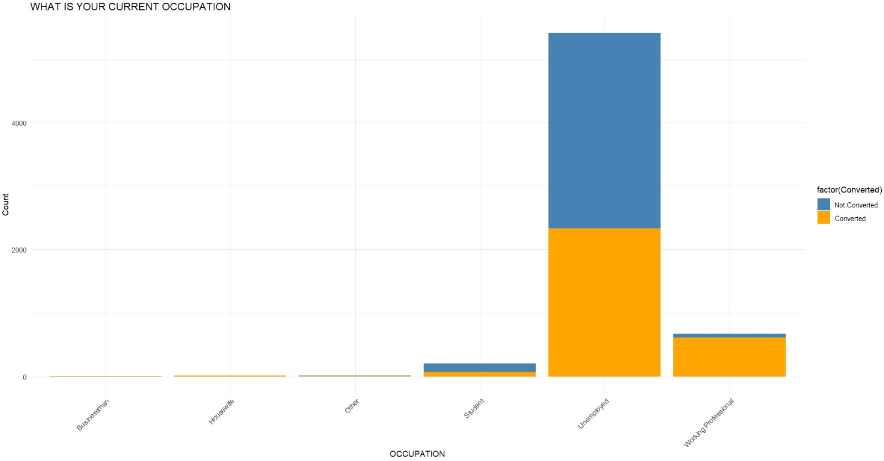
Analyzing Categorical Variable “WHAT IS YOUR CURRENT OCCUPATION”
The below histogram shows we have maximum leads from Unemployed for both converted and not converted categories but the working Professionals going for the course have high chances of joining the course.
Replaced the null values as Not Specified

Slide 21
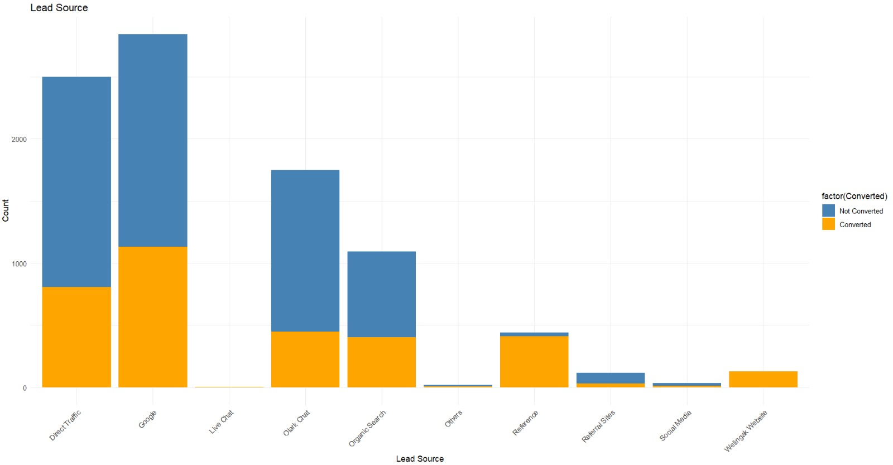
Analyzing Categorical Variable “Lead Source”
The below histogram shows we have maximum leads from Direct Traffic and Google Search
Leads through Reference and Welingak Website have the highest conversion rate which is more than 90 percent
To improve overall lead conversion rate, focus should be on improving lead converion of olark chat, organic search, direct traffic, and google leads and generate more leads from reference and welingak website.
Replaced low frequency values with “others” to mitigate the creation of excessive number of dummies.

Slide 22
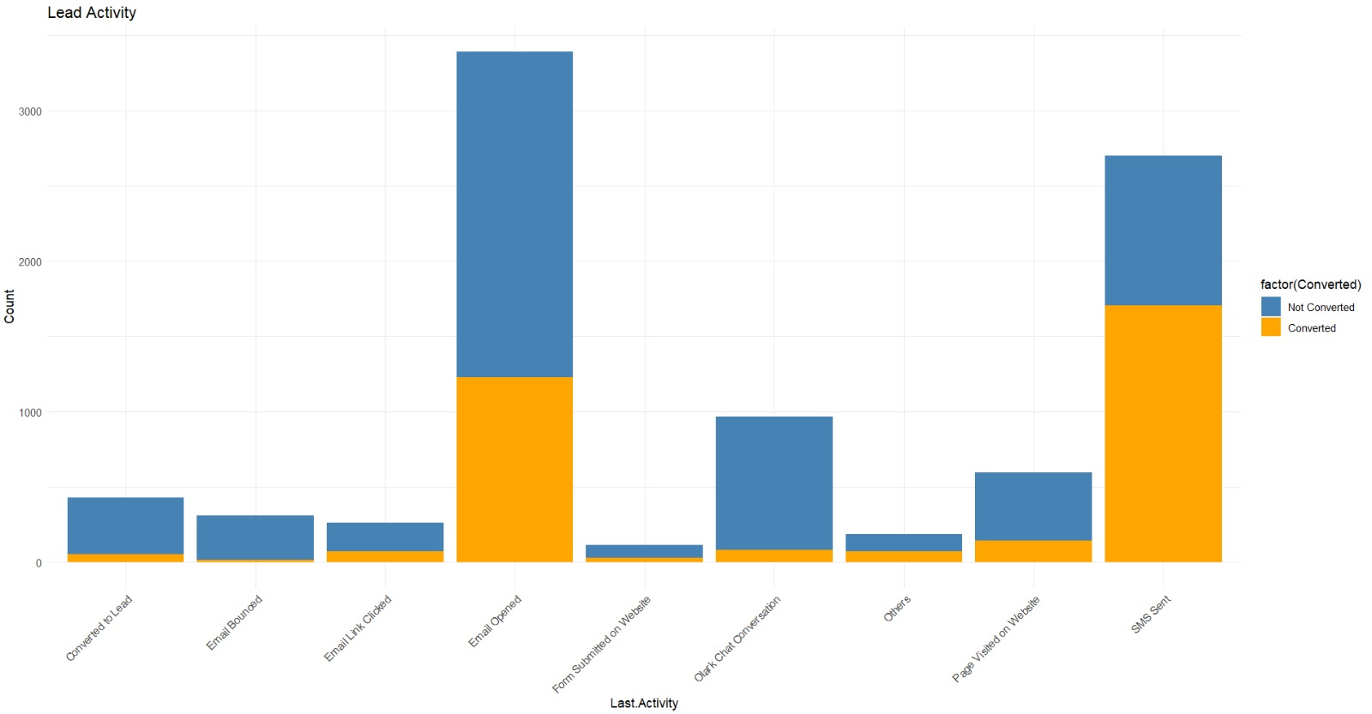
Analyzing Categorical Variable “LAST ACTIVITY”
Replaced low frequency values with 'Others’ as mentioned below.

Slide 23
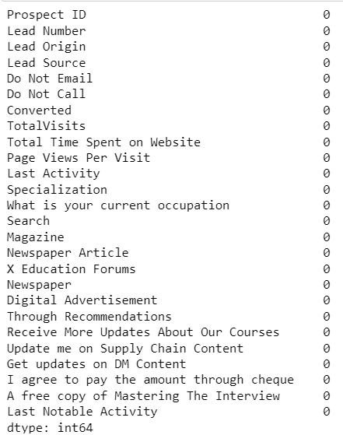
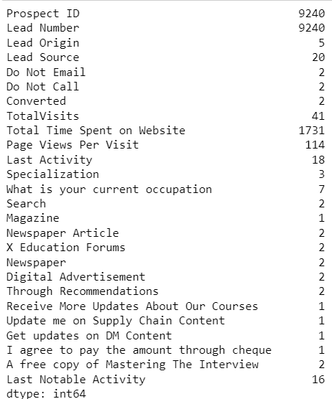
Handling Null Values
We have replaced the Null values in numerical columns with the median.
Columns that are of not much use for analysis are dropped from the data frame, the reason being the values in those columns are skewed and they wouldn't make much sense while analyzing and model building.
After the pre-processing, we are left with 14 columns.

Slide 24
Data Pre-processing and Modelling

Slide 25
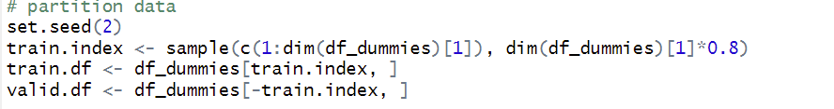
Training and Modelling
The whole dataset is partitioned into 2 parts for training and testing the models in the ratio
80% to 20% respectively.
We have used standard scaling and then applied various classification algorithms, to gather the models with the highest accuracy. [Logistic regression, K Nearest Neighbor, Support Vector Machine, Decision Tree, Gradient Boosting]

Slide 26
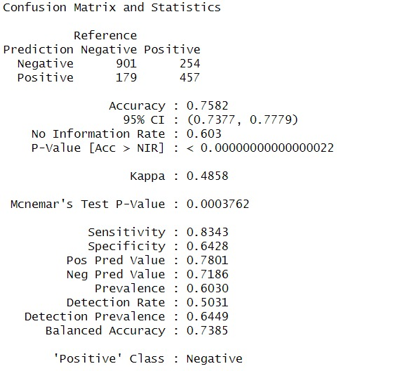
Logistic Regression
We got an accuracy of 75.82%, which can be considered a good accuracy

Slide 27
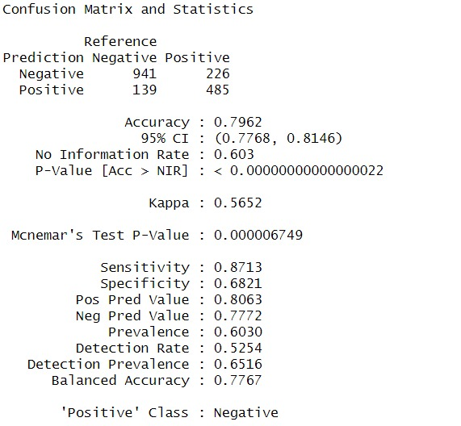
Support Vector Machine
We got an accuracy of 79.62%, a 4% gain from Logistic Regression

Slide 28
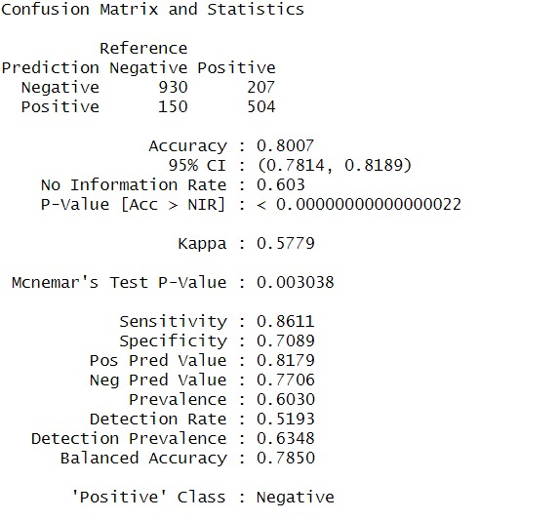
K Nearest Neighbor
We got an accuracy of 80.07% with K value set to 10

Slide 29
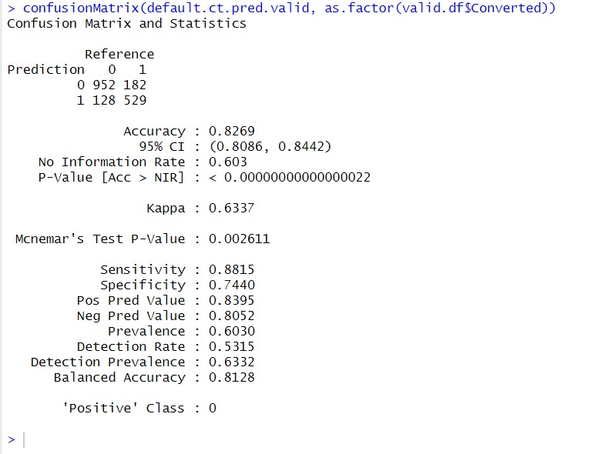
Decision Tree
We got an accuracy of 82.69%

Slide 30
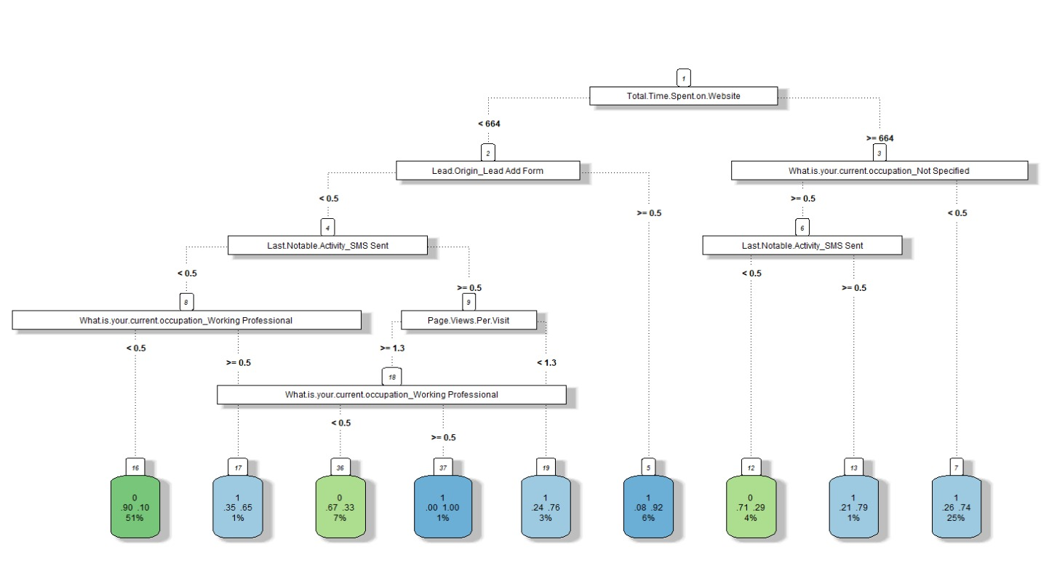
Decision Tree

Slide 31
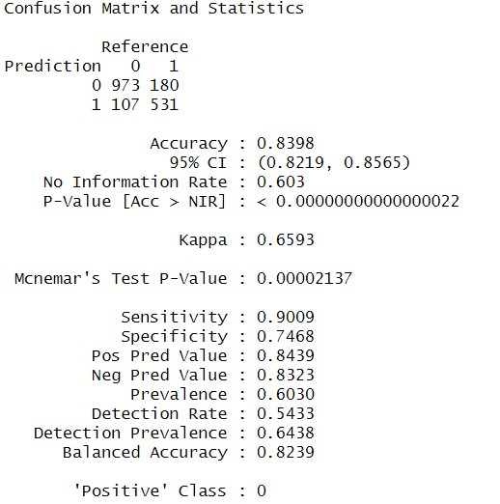
Gradient Boosting
We got an accuracy of 83.98%, which can be considered a good accuracy

Slide 32
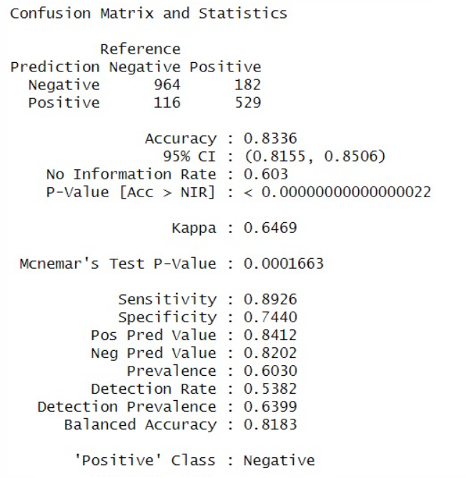
Random Forest
We got an accuracy of 83.53%, which can be considered a good accuracy

Slide 33
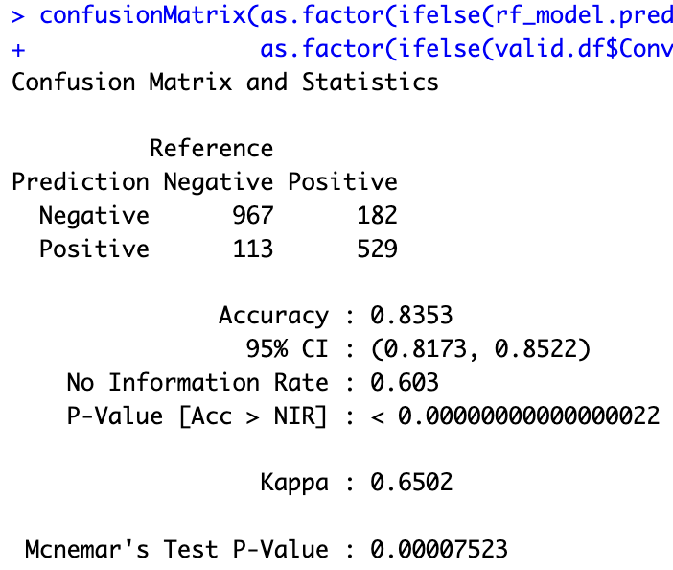
Neural Networks
We got an accuracy of 82.13%, which can be considered a good accuracy

Slide 34
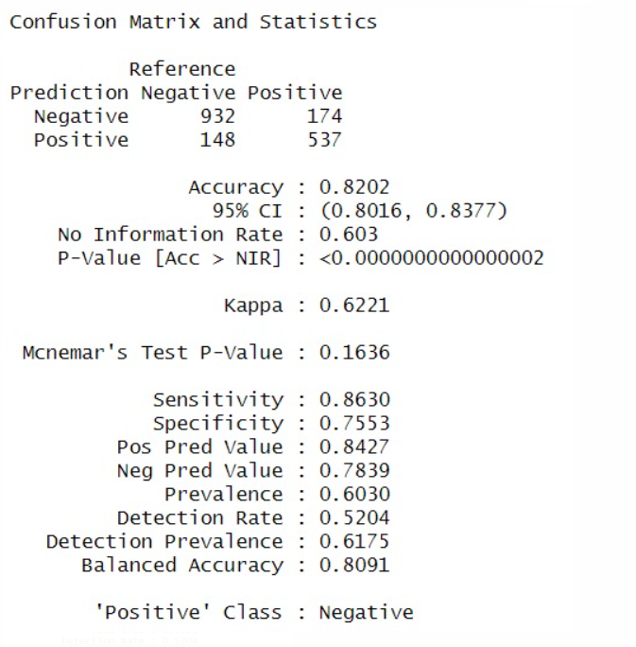
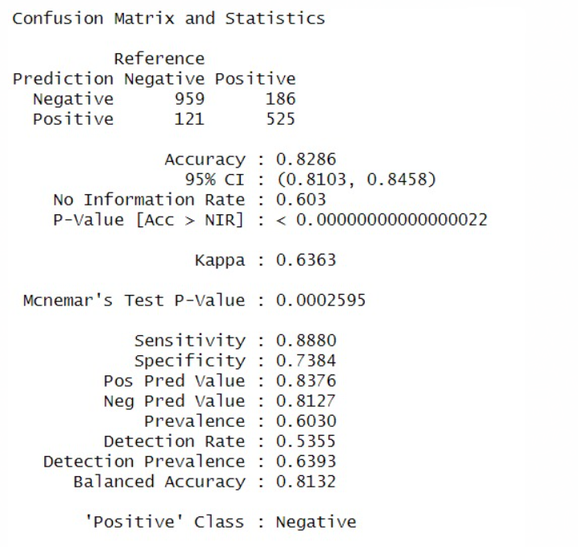
Ensemble Model
We built an two ensemble models (averaging and weighted averaging) using Logistic Regression, KNN, Decision Tree, and Gradient Boosting
Averaging
Weighted Averaging

Slide 35
Model Comparison
Model | Accuracy | Area Under Curve(AUC)
Logistic Regression | 73.14% | 72.03%
Support Vector Machines | 79.12% | 86.00%
K – Nearest Neighbour | 80.07% | 85.81%
Gradient Boosting | 83.92% | 91.47%
Decision Tree | 82.69% | 85.43%
Random Forest | 83.53% | 90.90%
Neural Networks | 82.13% | 89.91%
Ensemble Model | 79.51% | 89.12%

Slide 36
Key Takeaways
It was found that the variables that mattered the most in the potential buyers are (In descending order) :
1. The total time spend on the Website.
2. Total number of visits.
3. When the lead source was:
a. Google
b. Direct traffic
c. Organic search
d. Welingak website
4. When the last activity was:
a. SMS
b. Olark chat conversation
5. When the lead origin is Lead add format.
6. When their current occupation is as a working professional.

Slide 37
Potential impact on society/business/organization
To increase the conversion rate, ABC Education only needs to focus on the most likely potential clients first. They don't need to make many modifications to their current workflow.
As we will give the company all the necessary information on which potential customers to prioritize, they can operate within their current capacity without needing any additional resources.
By altering the model, it is possible to include any attribute changes and keep the model functioning effectively in the face of future modifications
Notes:
Charanya

Slide 38
Questions

Slide 39
Thank You!

